Slide 1

DNS
Computer System Engineering, Fall 2018. (IPADS, SJTU)
Naming in the Internet
Yubin Xia

Slide 2
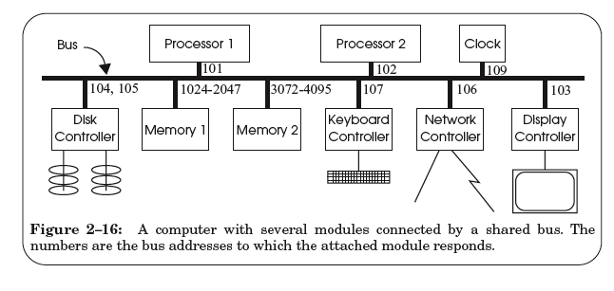
Review: Bus

Slide 3
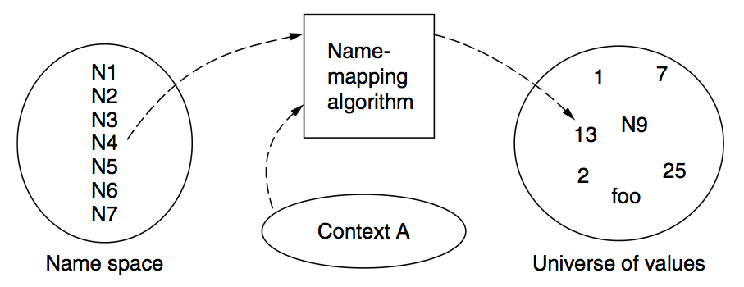
Review: the Naming Model

Slide 4
FAQ of Naming Scheme
What is the syntax of names?
What are the possible value?
What context is used to resolve names?
Who specifies the context?
Is a name global (context-free) or local?
Does every name have a value?
Can a single name have multiple values?
Does every value have a name?
Can a single value have multiple names?
Can the value of a name change over time?

Slide 5
The Design of DNS
Domain Name Service

Slide 6
DNS: Binding IP and Domain Name
Names: hostname strings
E.g., www.sjtu.edu.cn
Values: IP addresses
E.g., 202.120.2.119
Look-up algorithm
Resolves a hostname to an IP address so that your machine knows where to send packets

Slide 7
IP Address as a Type of Name
An IP address itself is a type of name
A structured name that is used to locate an object
Use IP address to identify the server
Recall your labs in ICS on socket
On Internet
The router will know where to send a packet with destination IP
Hostname has no such semantic
A router does not know how to send a packet to “baidu.com”

Slide 8
Why Not Just Using IP Address?
IPs are structured in a particular way for routing
You cannot chose your IP address as you wish
Note: usually an address cannot be picked
While you can chose your host names
IPs are not user-friendly enough

Slide 9
Questions on DNS
Q: Can a name have multiple values (IP addresses)?
Yes
This allows a web server to balance its load over multiple machines
Also allows a client to choice a nearest IP to access
Q: Can a single value have multiple names?
Yes
This allows server consolidation

Slide 10
Questions on DNS
Q: Can the value corresponding to a name change?
Yes
This allows to change the physical machine (with different IP) that stores the data without changing the hostname
Such changing is hidden to clients

Slide 11
Look-up Algorithm
At first, each machine kept a “hosts.txt” for address binding
E.g., “r900 202.120.224.83”
Using table look-up to resolve the binding
This method cannot scale in Internet
1984, four Berkeley students wrote BIND
Berkeley Internet Name Domain
Still the dominant DNS software in use

Slide 12
Distributing Responsibility
The binding
Too large to be stored on a single machine
Thus, the data are stored on many machines
As known as “name servers”
How to know which name server has a particular binding?
Solution: structure the hostname
Names have a hierarchy, e.g., com, net, gov, correspond to “zones”
Zones are mapped to name servers

Slide 13

Name Servers
The root zone
Maintained by ICANN, non-profit
The “.com” zone
Maintained by VeriSign, add for money
The “.sjtu.edu.cn” zone
Maintained by SJTU

Slide 14
DNS Hierarchy (a partial view)
root
com
cn
net
org
gov
apple
google
com
edu
drive
mail
www
fudan
sjtu
se
seiee
ma
ipads
www

Slide 15
Basic DNS Look-up Algorithm
Example: lookup IP of “ipads.se.sjtu.edu.cn”
Traverse the name hierarchy from the root
The root will tell us the “cn” name server IP,
which will tell us the “edu.cn” name server IP,
which will tell us the “sjtu.edu.cn” name server IP,
which will tell us the “se.sjtu.edu.cn” name server IP,
which finally tells us the “ipads.se.sjtu.edu.cn” IP
Such algorithm is called delegation

Slide 16
DNS Lookup
root
com
cn
com
edu
fudan
sjtu
se
ipads
www

Slide 17
DNS Lookup
198.41.0.4
root
cn: 202.112.0.44
com
cn
com
edu
fudan
sjtu
se
ipads
www
Notes:
com: 192.5.6.30
com.cn: 210.72.13.83

Slide 18
DNS Lookup
198.41.0.4
root
cn: 202.112.0.44
com
cn
edu.cn: 202.112.0.35
com
edu
fudan
sjtu
se
ipads
www
Notes:
com: 192.5.6.30
com.cn: 210.72.13.83

Slide 19
DNS Lookup
198.41.0.4
root
cn: 202.112.0.44
com
cn
edu.cn: 202.112.0.35
com
edu
sjtu.edu.cn: 202.120.2.101
fudan
sjtu
se
ipads
www
Notes:
com: 192.5.6.30
com.cn: 210.72.13.83

Slide 20
DNS Lookup
198.41.0.4
root
cn: 202.112.0.44
com
cn
edu.cn: 202.112.0.35
com
edu
sjtu.edu.cn: 202.120.2.101
fudan
sjtu
se.sjtu.edu.cn: 202.120.40.2
se
ipads
www
Notes:
com: 192.5.6.30
com.cn: 210.72.13.83

Slide 21
DNS Lookup
198.41.0.4
root
cn: 202.112.0.44
com
cn
edu.cn: 202.112.0.35
com
edu
sjtu.edu.cn: 202.120.2.101
fudan
sjtu
se.sjtu.edu.cn: 202.120.2.101
se
ipads.se.sjtu.edu.cn: 202.120.40.188
ipads
www
Notes:
com: 192.5.6.30
com.cn: 210.72.13.83

Slide 22
Context in DNS
Names in DNS are global (context-free)
A hostname means the same thing everywhere in DNS
Actually, it should be “ipads.se.sjtu.edu.cn.”
A hostname is a list of domain names concatenated with dots
The root domain is unnamed, i.e., “.” + blank

Slide 23
Fault Tolerant
Each zone can have multiple name servers
A delegation usually contains a list of name servers
If one name server is down, the others can be used

Slide 24
Three Enhancements on Look-up Algorithm
1. The initial DNS request can go to any name server, not just the root server
Even on your own machine: /etc/hosts
You can specific name servers in /etc/resolv.conf
If no record, just returns address of the root server
Q: what are the benefits?

Slide 25
Three Enhancements on Look-up Algorithm
2. Recursion
A client asks a name server “www.baidu.com”
The name server does all the lookup through the tree and return the IP of Baidu to the client
Usually, a name server has a better network connection

Slide 26
DNS Request Process
a.root.net
a.root.net
names.edu
names.edu
NS: for edu
ns.iss.edu
ns.iss.edu
NS: for
Scholarly.edu
ginger.
Scholar.edu
ginger.
Scholar.edu
ginger.
Scholar.edu
AP: for
ginger.Scholar.edu
Name client
Name client
Non-Recursion
Recursion

Slide 27
Three Enhancements on Look-up Algorithm
3. Caching
DNS clients and name servers keep a cache of names
Your browser will not do two look-ups for one address
Cache has expire time limit
Controlled by a time-to-live parameter in the response itself
E.g., SJTU sets the TTL of www.sjtu.edu.cn to 24h
TTL (Time To Live)
Long TTL VS. short TTL
Q: what are the tradeoffs?

Slide 28
Combine These Enhancements
If
Many machines at SJTU use the SJTU name server for their initial DNS query
The name server offers recursive querying and caching
Then
The name server’s cache will holding many bindings
Performance benefits from this large cache

Slide 29
Other Features of DNS
At least two identical replica servers
80 replicas of the root name server in 2008
Replicas are placed separated around the world
Organization’s name server (e.g., SJTU)
Several replicas in campus
To enable communications within the organization
At least one out of the campus
To validate the address for outside world

Slide 30
Name Discovery in DNS (at the first place)
A client must discover the name of a nearby name server
Name discovery broadcast to ISP at first time
Ask network manager
Ask by email, Google, etc.

Slide 31
Comparing Hostname & Filename
They are both for more user friendly
File name -> inode number
Hostname -> IP address
The file name and hostname are hierarchical; inode num and IP address are plane
They are both not a part of the object
File name is not a part of a file (stored in directory)
Hostname is not a part of a website (stored on name server)
Name and value binding
File: 1-name -> N-values (no); N-name -> 1-value (yes)
DNS: 1-name -> N-values (yes); N-name -> 1-value (yes)

Slide 32
Behind the DNS Design
Why was DNS designed in this way?

Slide 33
Benefits of Hierarchical Design
Hierarchies delegate responsibility
Each zone is only responsible for a small portion
Hierarchies also limit interaction between modules
A type of de-centralization

Slide 34
Good Points on DNS Design
Global names (assuming same root servers)
No need to specific a context
DNS has no trouble generating unique names
The name can also be user-friendly
Scalable in performance
Simplicity: look-up is simple and can be done by a PC
Caching: reduce number of total queries
Delegation: many name severs handle lookups

Slide 35
Good Points on DNS Design
Scalable in management
Each zone makes its own policy decision on binding
Hierarchy is great here
Fault tolerant
If one name server breaks, other will still work
Duplicated name server for a same zone

Slide 36
Bad Points on DNS Design
Policy
Who should control the root zone, .com zone, etc? Government?
Significant load on root servers
Many DNS clients starts by talking to root server
Many queries for non-existent names, becomes a DoS attack
Security
How does a client know if the response is correct?
How does VeriSign know “change Amazon.com IP” is legal?

Slide 37
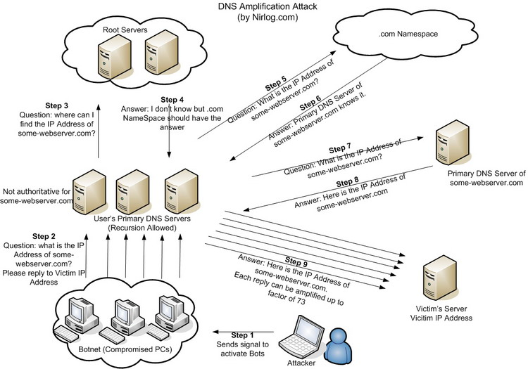
DNS Amplification Attack

Slide 38
DNS Security
DNS Hijack: Cutting the binding between name and IP
DNS DoS (Denial of Service) attack
BAOFENG.com & DNSPod
2009-5-18: DNSPod is attacked and banned
2009-5-19: The Internet in China is almost down
Fixed timer: query for BAOFENG.com once per second!
Solutions
/etc/hosts, dnsmasq, OpenDNS, etc.
DNS shield to defend against DoS attack

Slide 39

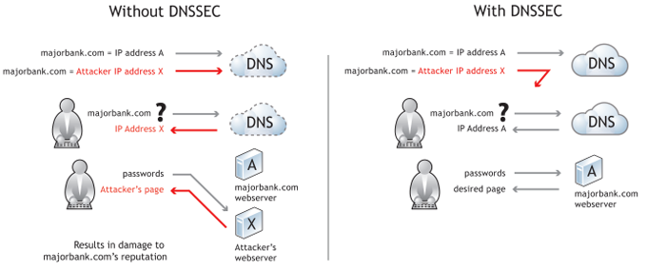
DNSSEC: Protect DNS Record
Only part of the zones are using DNSSEC, e.g., .gov, .org

Slide 40
Problem 4.5
While browsing the Web, you click on a link that identifies an Internet host named www.cslab.scholarly.edu. Your browser asks your Domain Name System (DNS) name server, M, to find an Internet address for this domain name. Under what conditions is each of the following statements true of the name resolution process?

Slide 41
Problem 4.5
To answer your query, M must contact one of the root name servers.
If M answered a query for www.cslab.scholarly.edu in the past, then it can answer your query without asking any other name server.
M must contact one of the name servers for cslab.scholarly.edu to resolve the domain name.
Notes:
Ex. 4.5
A is true only when M’s cache misses and the prefix of the name has nothing in common with the domain that M serves.
B will be true only if the time-to-live of the DNS record cached by M has not expired. If the binding found by M in its cache for www.cslab.scholarly.edu has expired, then M must contact at least one other name server to resolve the domain name.
C is true only if M has no valid information in its cache for www.cslab.scholarly.edu.

Slide 42
Problem 4.5
If M has the current Internet address of a working name server for scholarly.edu cached, then that name server will be able to directly provide an answer.
If M has the current Internet address of a working name server for cslab.scholarly.edu cached, then that name server will be able to directly provide an answer.
Notes:
D is not usually true, because the scholarly.edu name service will normally refer M to the cslab.scholarly.edu name service, rather than answer the query itself. (Though it is possible to configure a name service to directly contain the data for one or more of its subdomains.)
E will normally be true, though it is possible that the name is a synonym that requires cslab.scholarly.edu to ask yet another name server for help.

Slide 43
Client & Server
Enforced modularity

Slide 44
Why Enforced Modularity?
Modularity itself is not enough
Programmers make mistakes
Mistakes propagate easily
A way to strengthen the modularity is needed

Slide 45
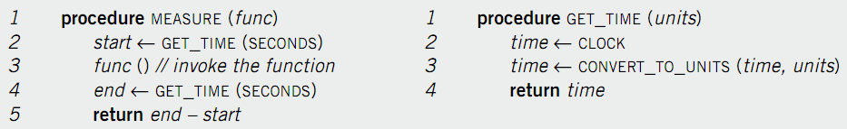
Modularity in the Code
Modularity in the code
E.g. hide CLOCK’s physical address
E.g. hide time unit
No need to change MEASURE on another computer, only change GET_TIME
… but not enough

Slide 46
Soft Modularity
Error leaks from one module to another
Function call
Stack discipline
Procedure calling convention

Slide 47
Potential Problems in Calling - 1
Errors in callee may corrupt the caller’s stack
The caller may later compute incorrect results or fails
Callee may return somewhere else by mistake
The caller may lose control completely and fail
Callee may not store return value in R0
The caller may read error value and compute incorrectly
Caller may not save temp registers before the call
The callee may change the registers and causes the caller incorrect

Slide 48
Potential Problems in Calling - 2
Callee may have disasters (e.g. divided by 0)
Caller may terminate too, known as fate sharing
Callee may change global variables that it shouldn’t change
Caller and callee may compute incorrectly or fail altogether
Even other procedures may be affected
Procedure call contract provides only soft modularity
Attained through specifications
Cannot force interactions among modules to their defined interfaces

Slide 49
Enforced Modularity is Needed
Using external mechanism
Limits the interaction among modules
Reduces the opportunities for propagation of errors
Allows verification that a user uses a module correctly
Prevent an attacker from penetrating the security of a module

Slide 50
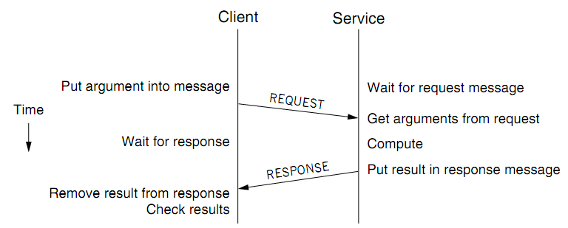
Client/Service Organization
Limit interactions to explicit messages
Client: request; service: response or reply
On different computers, connected by a wire
Chap 5 will explain how to get them into one computer

Slide 51
C/S Model
Client/Service model
Separates functions (abstraction)
Enforces that separation (enforced modularity)
Reduce fate sharing but not eliminate it
Notes:
Occam’s Razor.

Slide 52
Multiple Clients and Services
One services can work for multiple clients
One client can use several services
One module can be both a client and a service
Printer as a service for printing request
Also a client of the file service

Slide 53
Trusted Intermediaries
Service as trusted 3rd party
Run critical procedures as a service
E.g., a file service to keep clients’ file distinct, email service
Enforces modularity among multiple clients
Ensures that a fault in one client has limited effect on another client
Thin client computing (the ultimate version of C/S?)
Simplify clients by having the trusted intermediary provide most functions
Only the trusted intermediaries run on powerful computers
What if the powerful computers fail…

